Slide 1
Building A Blockchain Ledger
Dan Stevens (djs447)

Slide 2
Goals
Objective is to build a blockchain ledger and demonstrate its basic functionality
Highlight differences between blockchain and a traditional database
Show what advantages blockchain may offer and how blockchain works
Demo has been included as a script to walk through some of the essential blockchain functions

Slide 3
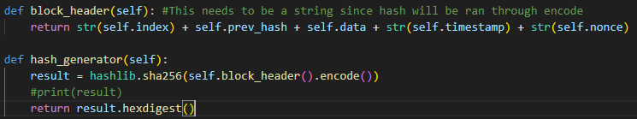
Blockchain Structures
Block
Index: A block’s position within the chain
Timestamp: The time the block was created
Prev_hash: The hash value of the previous block in the chain
Data (Transactions): The message, data, string, etc. being stored by the block
Nonce: Initialized to 0, this value is incremented to satisfy the proof-of-work concept
Hash: The assigned value according to the hashing algorithm (SHA-256 in this implementation) and the block header (concatenated string of the index, timestamp, data, previous hash, and nonce)
Blockchain
Blocks: A list of every block within the blockchain. New blocks are added to the end of this list
Zeroes: The number of leading zeroes necessary to satisfy the proof-of-work concept

Slide 4
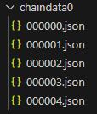
Blockchain Structures
Node
Node_id: Integer identifier for tracking / labeling nodes within a larger network
Peers: A list of nodes that each node has a direct connection to
Blockchain: The version of the blockchain maintained by a specific node

Slide 5

Proof-of-Work Concept
The blockchain expects each block to have a hash value with a specific number of leading zeroes
Part of determining validity, the number of zeroes here is kept static
The hash is generated and if this isn’t satisfied, the nonce is incremented and the hash re-generated
This slows down the mining process and improves security

Slide 6
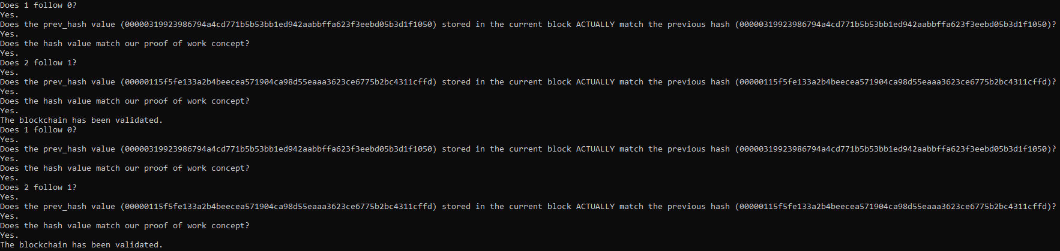
Validity
Three Checks are Performed for Validity:
The blocks are in the correct order
Each block within the blockchain is valid (that is, each block satisfies the proof-of-work concept)
The hash values of each block match the expected values stored by the “prev_hash” variable of the following block

Slide 7
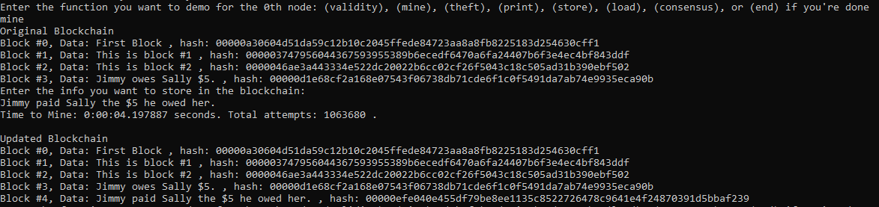
Mining
This implementation will either create a new block storing generic data or user input
The mining process repeats until the proof-of-work concept is satisfied
Outputs the time it took to mine as well as the total attempts (stored by the nonce value)

Slide 8
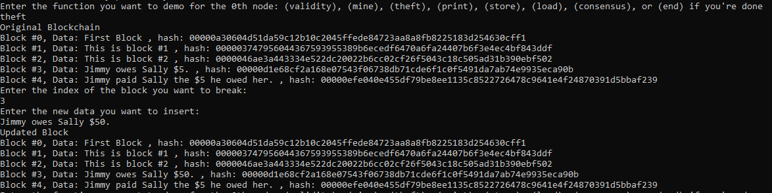
Stealing / Editing Data
If we can manipulate the data stored in the blockchain, then it is possible for someone to steal from anyone else
Issue in this image is that the blockchain has not been rehashed yet, fortunately the validity test re-hashes each block

Slide 9
Consensus
Function returns the ‘best’ chain, as determined by the length of the chain and validity
Once received, a node will replace it’s own blockchain version (if necessary) and then broadcast the best chain to its peers
Current flaw is that it will not settle disagreements between two nodes with equally long blockchains
Bitcoin solves this by having nodes maintain different potential branches for the blockchain and resolving these as information is received

Slide 10
Additional Demo Functions
Store: Creates a backup directory and stores the blockchain of the input node
Load: Loads the contents of the backup directory back into the input node
Print: Prints the contents of the blockchain of the input node

Slide 11
Thank You!

